Slide 1
REGISTRATION FORM for student
FOLLOWING MEMBERS:
Chino ascedillas
Christian agripino
Ryan bautista
Justine rhey royo

Slide 2
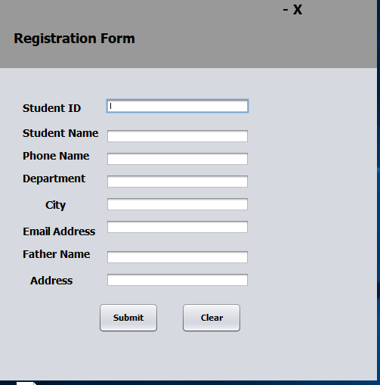
PROTOTYPE

Slide 3
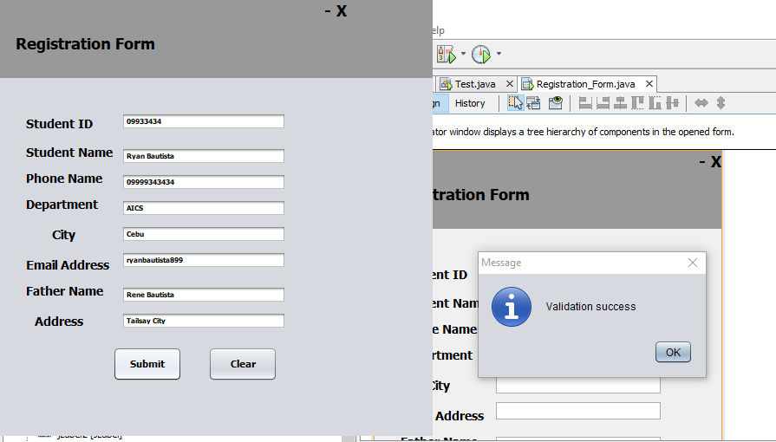
NOTE: User will input their basic information and click submit to their registration form

Slide 4
FUNCTIONS
ADD STUDENTS
UPDATE STUDENTS
ENROLLMENT FOR THE STUDENTS
SHOW THE LIST

Slide 5
THANKYOU GODBLESSED =)

Slide 6
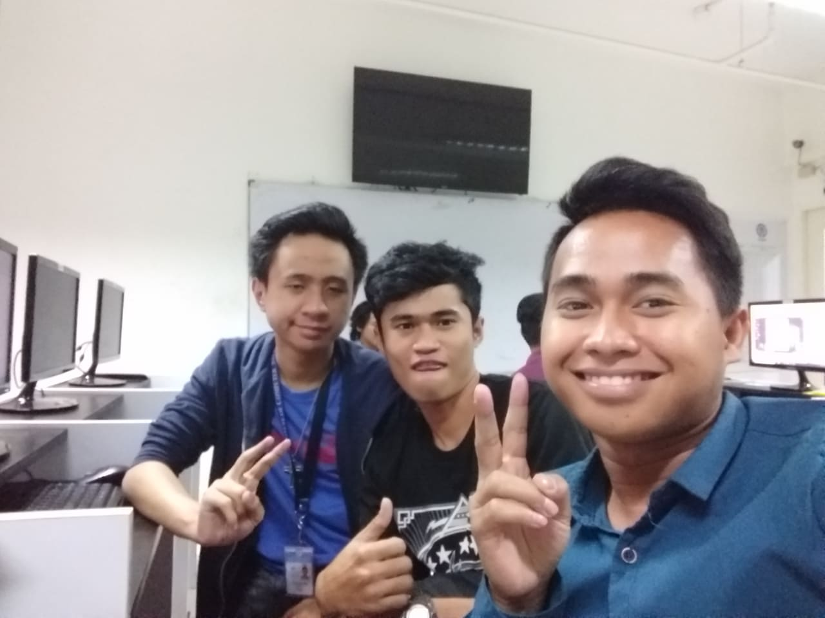
After coding:

